Slide 1

Seasonal Agriculture Performance Analysis
Student Name: YERRAMSETTY Hemantha Jawahar Krishna Babu
College Name: Vasavi college of engineering
AICTE STU ID: STU66182696628831712858774
Github : https://github.com/yjawahar/Jawahar--Seasonal-Agriculture-Performance-Analysis

Slide 2

PROBLEM STATEMENT
Agricultural performance changes with seasonal conditions, farming practices, resource availability, and market conditions. Raw agricultural data does not clearly show how these factors relate to yield, production, profit, and resource use.
This project analyzes the supplied agricultural dataset to identify meaningful seasonal patterns, relationships, and variations in agricultural performance.

Slide 3
Project Description
This project uses exploratory data analysis and statistical testing to compare agricultural performance across Kharif, Rabi, and Zaid seasons.
Analysis Workflow:
• Loaded and Reviewed Dataset: Loaded and reviewed the agricultural dataset comprising 4,000 observations across 28 features
• Checked Quality & Integrity: Checked missing values and duplicate records to ensure data cleanliness and consistency
• Cleaned & Imputed Data: Cleaned duplicate records (0 found) and imputed missing numeric values using median imputation
• Calculated Seasonal Summaries: Calculated seasonal summaries for yield, production, profit, water use, water efficiency, and profit margin
• Exploratory Visualizations: Visualized distributions, seasonal differences, and multi-variable correlations
• Statistical Testing: Used Kruskal-Wallis tests to assess observed differences across seasons rigorously
• Evidence-Based Recommendations: Developed evidence-based recommendations while treating the analysis as observational, not causal

Slide 4

WHO ARE THE END USERS?
The analytical findings and seasonal benchmarks directly benefit key agricultural stakeholders:
• Farmers: For comparing seasonal crop performance and resource use to select high-yield crops, optimize input schedules, and manage operational expenditures.
• Agricultural Planners: For identifying seasonal trends, water stress vulnerabilities, and regional production deficits that require timely logistical intervention.
• Extension Officers: For supporting crop- and region-specific guidance, promoting modern water-efficient irrigation methods, and delivering customized farm advisory.
• Researchers and Analysts: For investigating seasonal differences in farm outcomes with transparent, reproducible statistical workflows and empirical benchmarks.
• Agricultural Policy Stakeholders: For evidence-based resource allocation, market price support schemes, and sustainable resource management.

Slide 5

Technology Used
• Google Colab: Cloud-hosted Jupyter notebook platform used for interactive execution, testing, and team reproducibility.
• Python 3: Primary programming language providing scientific libraries and robust data manipulation capabilities.
• Pandas: Essential library for data ingestion, missing value imputation, multi-index aggregation, and seasonal summary generation.
• NumPy: High-performance vectorized mathematical calculations, metric transformations, and numerical operations.
• Matplotlib & Seaborn: Comprehensive plotting engines for univariate distributions, bivariate regressions, boxplots, and correlation heatmaps.
• SciPy (scipy.stats): Scientific computing library utilized for non-parametric Kruskal-Wallis hypothesis testing across seasons.
• CSV Dataset: Comprehensive agricultural records comprising 4,000 observations across 28 environmental, operational, and financial features.

Slide 6
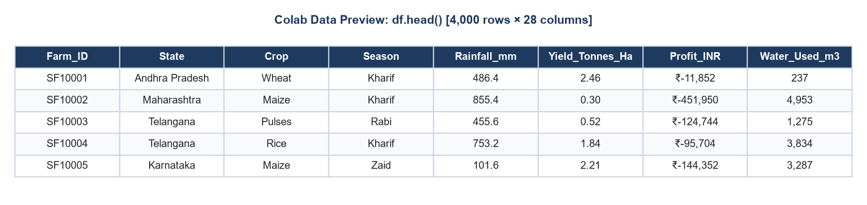
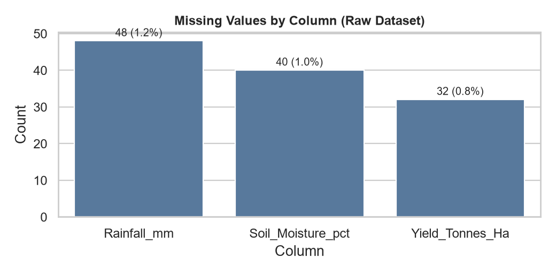
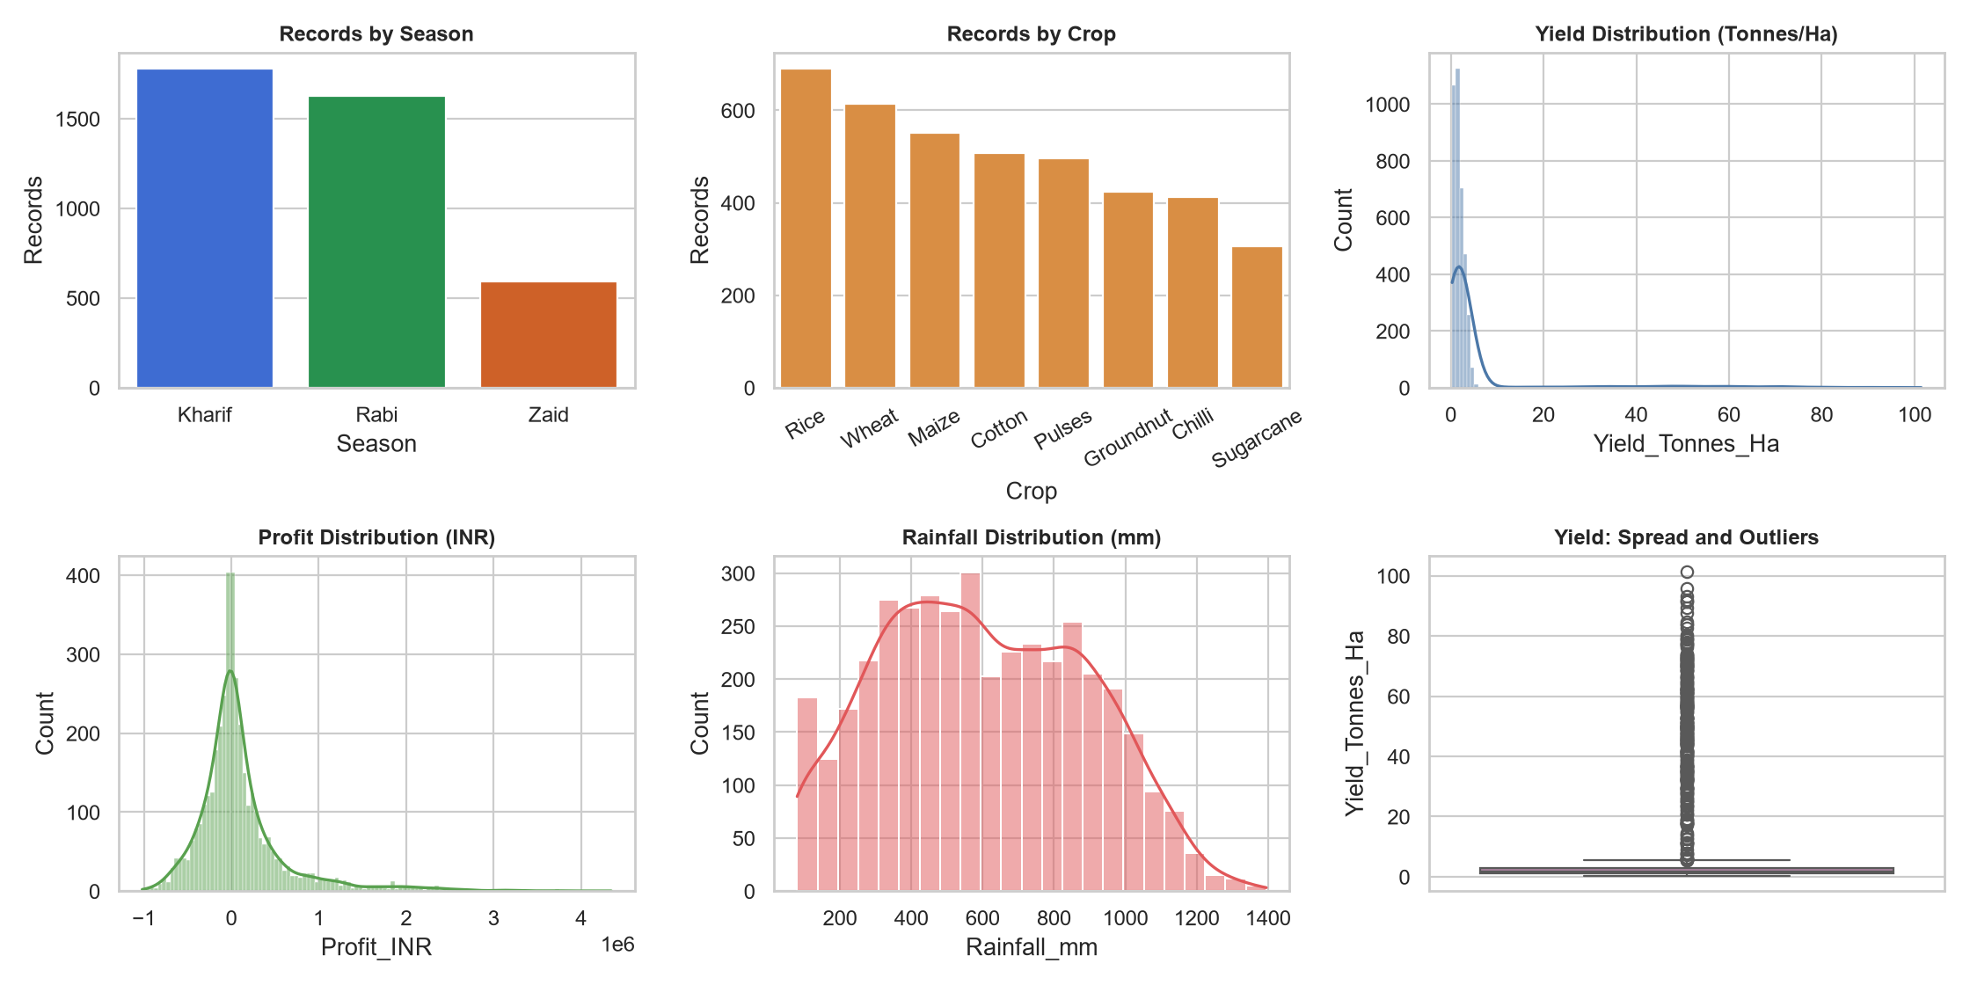
Data Quality and Exploratory Analysis
Caption: The dataset was reviewed before analysis. Duplicate records were removed (0 duplicates found), missing numeric values were handled using median imputation where required (Rainfall: 48, Soil Moisture: 40, Yield: 32), and categorical missing values were handled using the most frequent value where required.

Slide 7
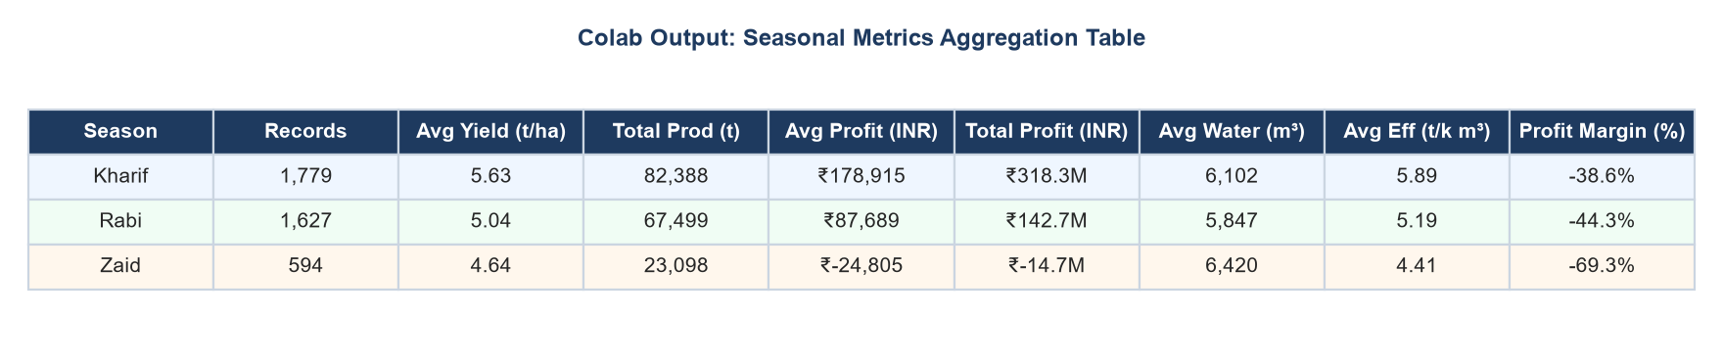
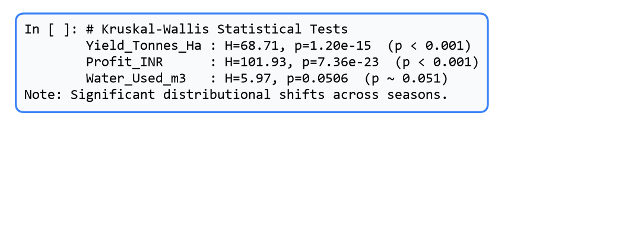
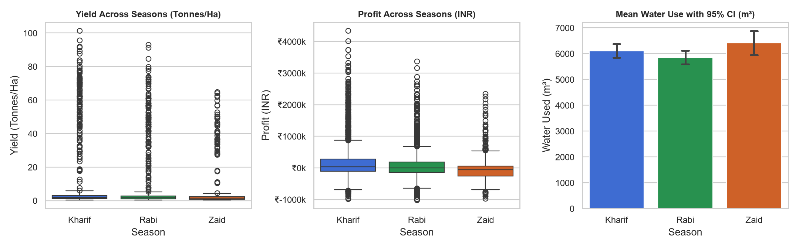
Seasonal Comparison of Agricultural Performance
The project compares average yield, total production, profit, water use, water efficiency, and profit margin across seasons. The notebook also applies Kruskal-Wallis tests to examine whether observed yield, profit, and water-use distributions differ across seasons.
Key Verified Findings: • Best-Yield Season: Kharif (5.63 t/ha; KW p=1.20e-15) • Highest-Profit Season: Kharif (Avg ₹178,915; KW p=7.36e-23) • Highest-Water-Use Season: Zaid (Avg 6,420 m³; KW p=0.0506). Observable differences confirm distinct seasonal performance dynamics.

Slide 8
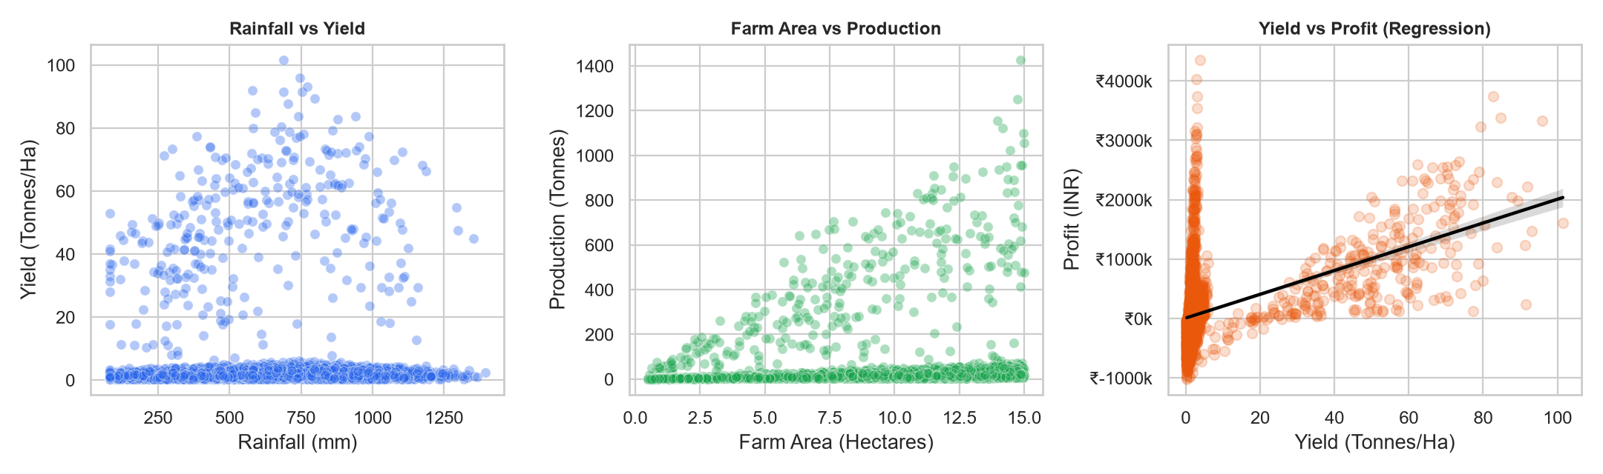
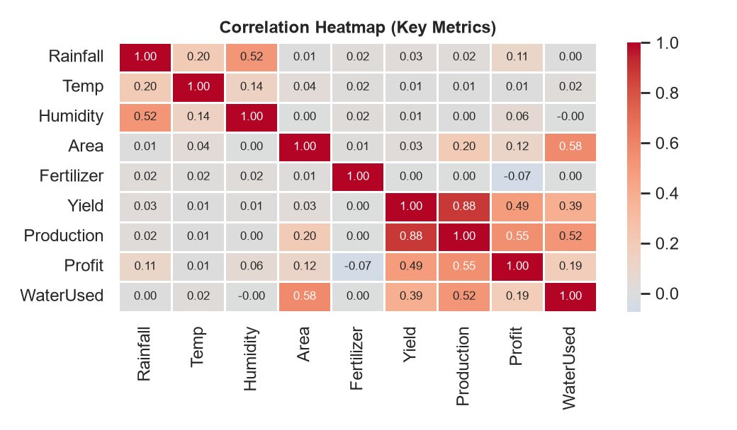
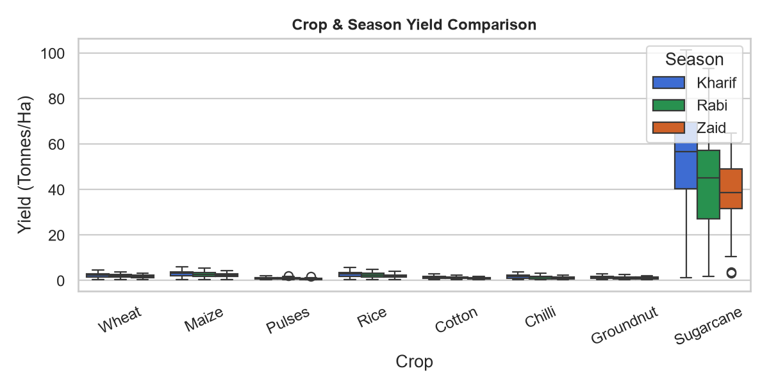
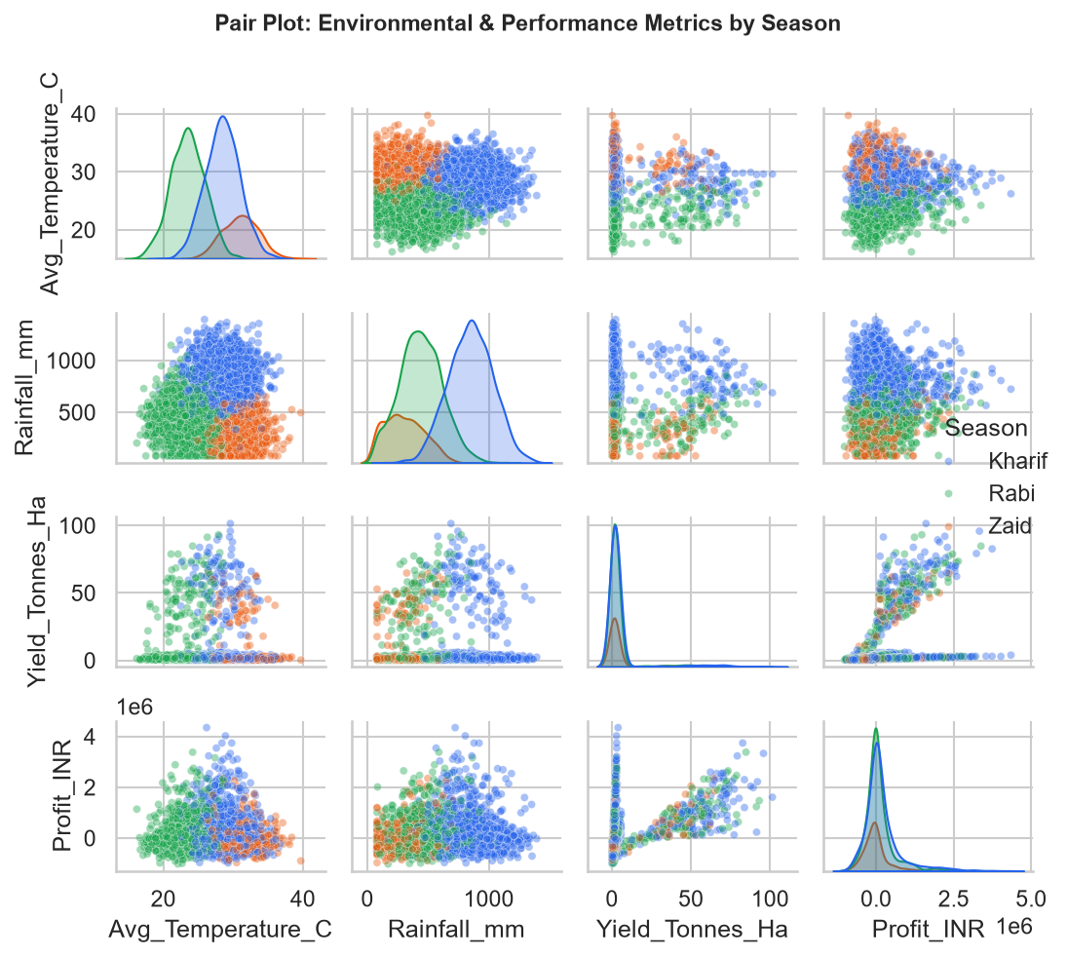
Environmental, Operational, and Economic Relationships
The analysis explores how environmental conditions, farm size, crop type, irrigation method, and seasonal conditions relate to yield, production, profit, and resource use. These relationships indicate observed associations and do not establish causation.

Slide 9
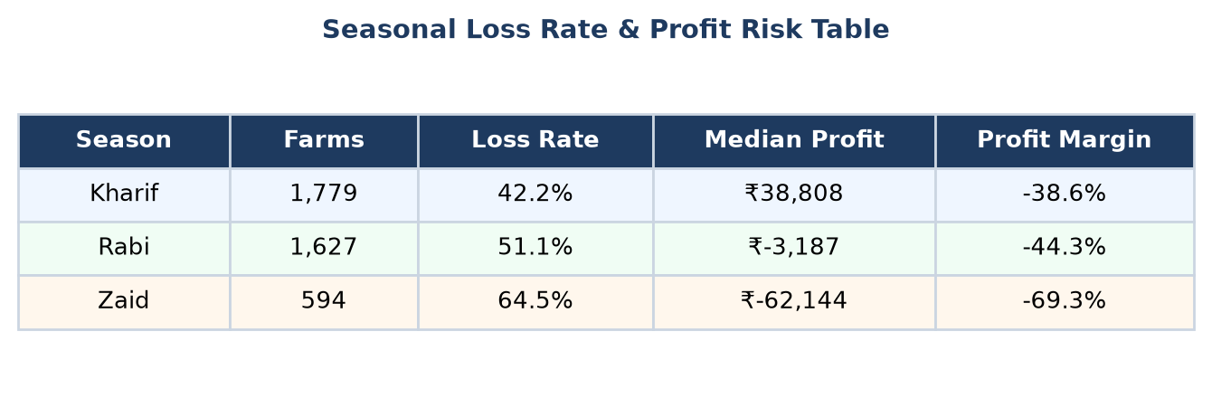
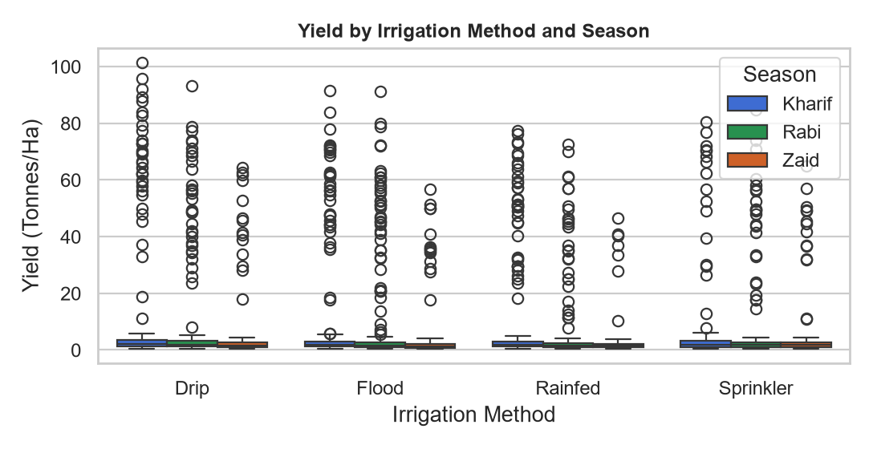
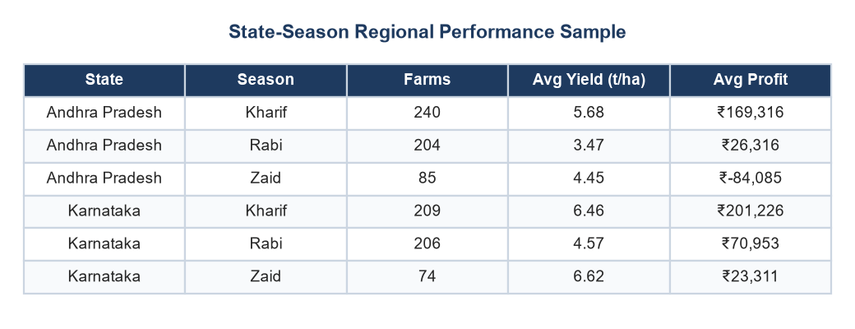
Risk, Irrigation, and Regional Insights
Evidence-Based Recommendations:
• Investigate High Loss Rates: Investigate the season with the highest observed loss rate (Zaid: 64.48% loss rate, Median profit: -₹62,144; Rabi: 51.14%) by reviewing crop mix, region, operational costs, and irrigation practices.
• Benchmark Within Same Crop & State: Compare high-performing seasonal practices within the same crop and state before applying them elsewhere; avoid direct cross-season assumptions.
• Targeted Water Management: Review water management where water use is high (Zaid: 6,420 m³) and observed water efficiency is low (4.41 t/1000m³), concentrating on high-efficiency drip/sprinkler adoption.
• Data Quality Verification: Validate IQR-flagged records against source data before removing observations from production models.
• Context-Specific Follow-Up: Use crop-, region-, and irrigation-specific follow-up rather than broad universal assumptions across diverse agricultural zones.

Slide 10
Conclusion
The analysis identifies measurable seasonal differences in agricultural yield, profitability, and resource use across Kharif, Rabi, and Zaid seasons.
Seasonal summaries, visual comparisons, and statistical tests help identify areas for targeted follow-up. The findings support better agricultural planning through crop-specific, region-specific, and irrigation-specific analysis.
Limitation:
This is observational analysis. The results show patterns and associations in the available dataset, but they do not prove that season alone caused the observed differences.

Slide 11
Future Scope
• Predictive Modeling: Build machine learning models for agricultural yield and profit forecasting using gradient boosting and ensemble techniques.
• Weather & Market Integration: Incorporate live weather forecast APIs and historical wholesale market-price data for dynamic price risk evaluation.
• Interactive Analytics Dashboards: Create interactive district-level and state-level dashboards for real-time visualization, KPI tracking, and alert triggers.
• Multi-Year Longitudinal Analysis: Study seasonal patterns across multiple consecutive years to separate climate trends from annual weather anomalies.
• Crop-Specific Irrigation Optimization: Evaluate granular crop-specific irrigation recommendations to maximize water productivity and mitigate water stress.
• Field-Level Operational Validation: Validate data-driven findings using precision agricultural sensors and field-level trial data from agricultural research stations.

Slide 12

Project Repository
https://github.com/yjawahar/Jawahar--Seasonal-Agriculture-Performance-Analysis.git
Scan the QR code to access the GitHub repository, Colab notebook, and dataset files

Slide 13
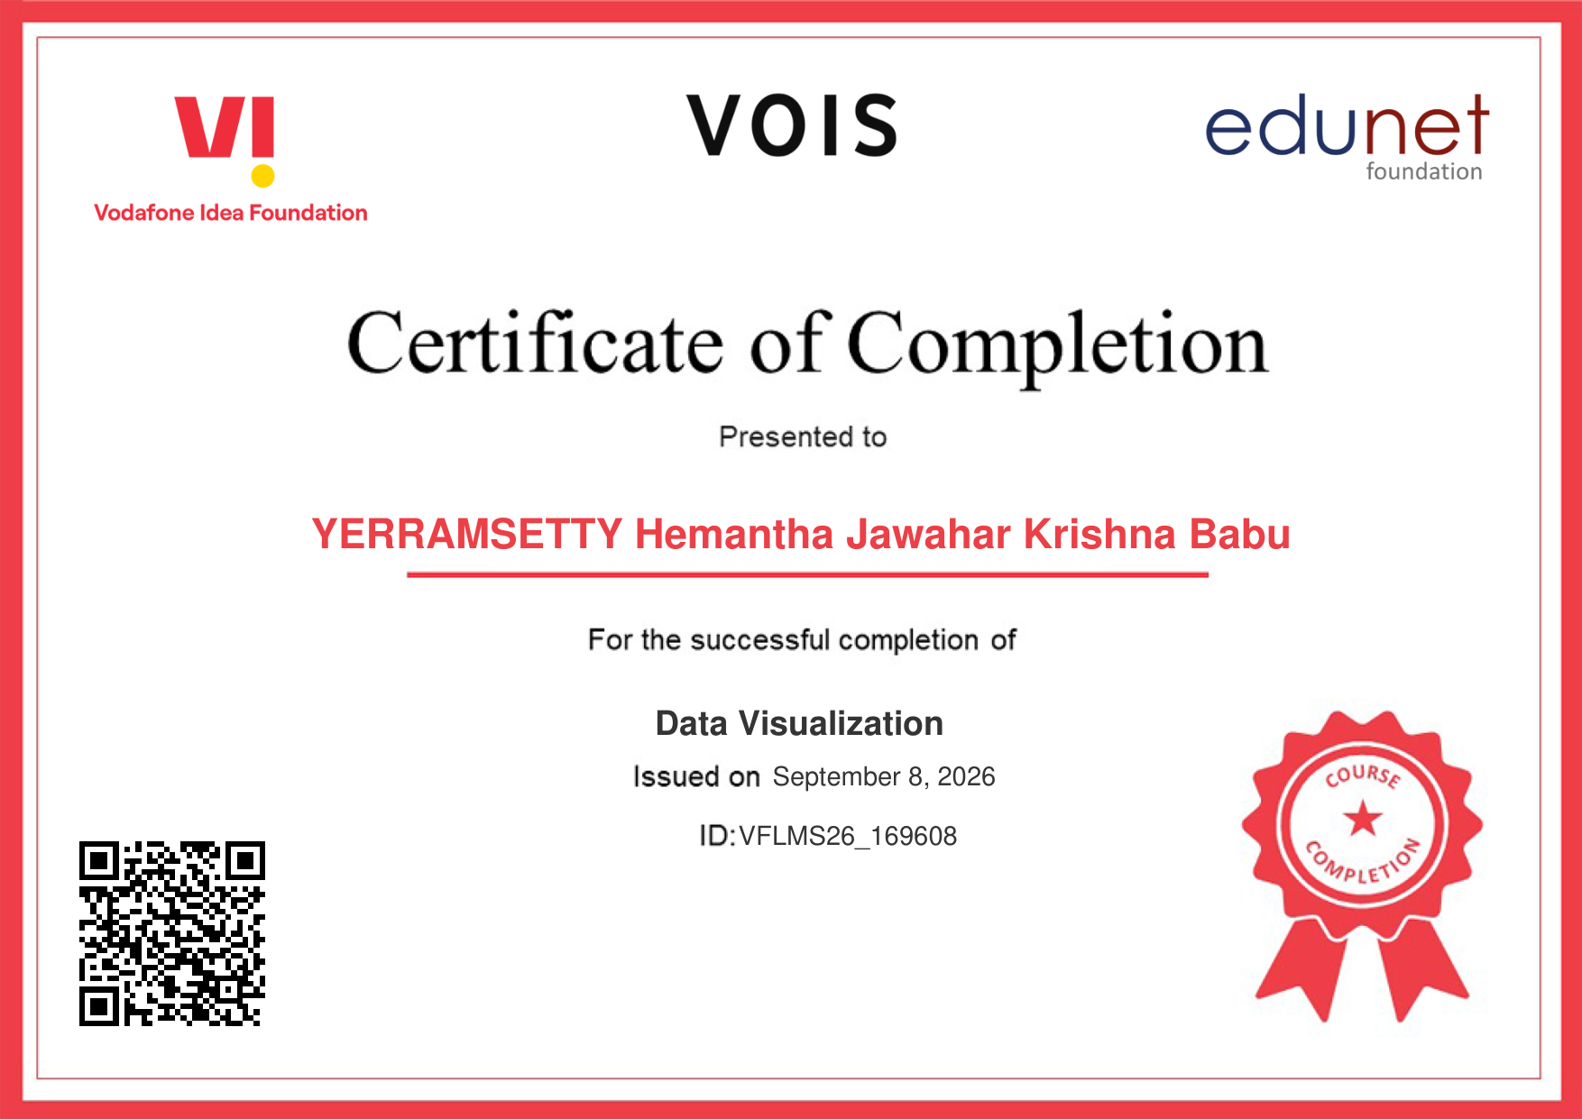
VOIS Course Completion Certificate
Course Name: Data Visualization | Awarded to: YERRAMSETTY Hemantha Jawahar Krishna Babu

Slide 14
Thank You
Questions and Discussion
Seasonal Agriculture Performance Analysis · VOIS AICTE Major Project 2026-2027

